Slide 1
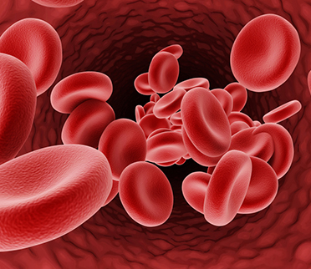
SEMINAR ON THALASSEMIA
Submitted To,
Mrs. Surekha Patil Madam
( Subject Teacher )

Slide 2

AIMS & OBJECTIVES
AIMS -
At the end of seminar group will be able to gain knowledge about thalassemia and apply this knowledge in clinical practice.
OBJECTIVES –
At the End of seminar group will understand –
Introduction
Definition of thalassemia
Types of thalassemia
Pathophysiology of thalassemia
Etiology of thalassemia
Clinical manifestation of thalassemia
Complications of thalassemia
Diagnostic evaluation of thalassemia
Medical Management
Surgical Management
Nursing Management

Slide 3
INTODUCTION
Thalassemia is a blood disorder passed down through families ( inherited ) in which the body makes an abnormal form of HB.
The disorder results in large number of RBCs being destroyed which leads to anemia.
Thalassemia is most often found in families of Chinese, south Asian and African origin.

Slide 4

DEFINITION
Thalassemia is a group of inherited disorders of hemoglobin synthesis characterized by a reduced or absent one or more of the globin chains of hemoglobin.

Slide 5
TYPES
There are two types of thalassemia –
Alpha Thalassemia ( Most Common )
When a gene or genes related to alpha globin protein are missing or changed
Alpha globin chains are absent in these type of thalassemia.
Alpha thalassemia occurs most often in people from southeast, Asia, middle east, china and those of African descent

Slide 6
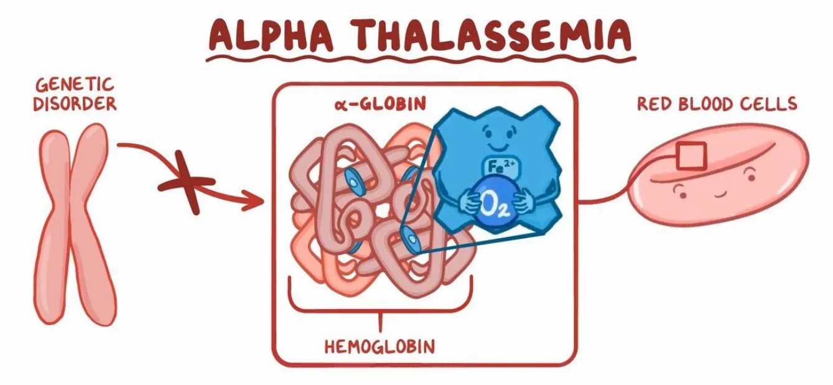

Slide 7
Beta Thalassemia
When similar genes defects affect the production of beta globin proteins
Beta globin chains are absent or reduced in this type of thalassemia
It mostly occurs often in peoples of Mediterranean origin, Chinese, Asian and African are less affected.

Slide 8
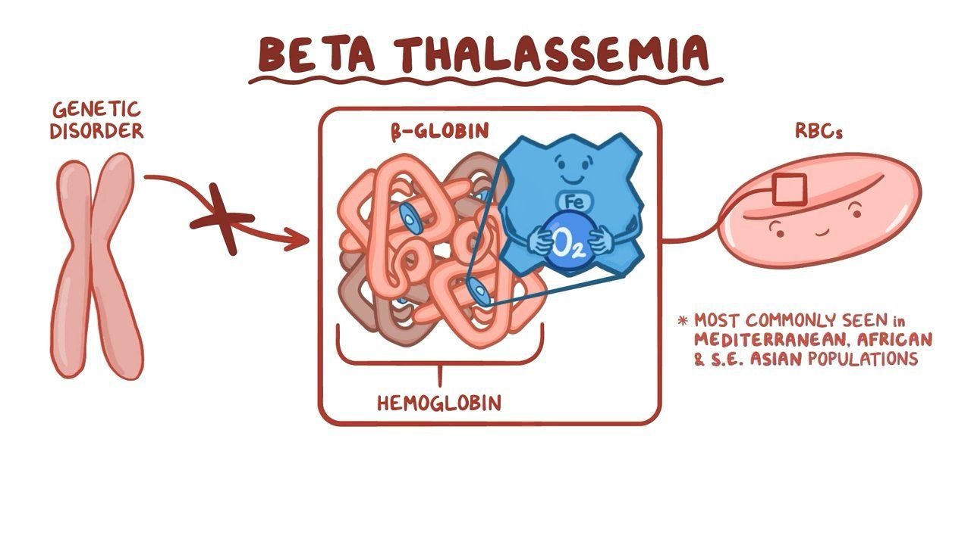

Slide 9
Both Alpha and Beta have different subtypes
Thalassemia major -
It is developed by inherited gene defects from both parents.
A homozygous person has two thalassemic genes causing a severe condition known as thalassemia major.
Thalassemia minor -
It includes the receiving of faulty gene from only one parent.
Those who inherit just one beta gene ( heterozygote ) have thalassemia minor also called thalassemia trait, the carrier state of thalassemia.
The person who is heterozygous has one thalassemic gene & one normal gene and is said to have thalassemic minor or thalassemia trait, the carrier state of thalassemia.

Slide 10
PATHOPHYSIOLOGY
Disturbance of ratio between alpha and non alpha globin chain synthesis then absent or decrease production of one or more globin chain.
Formation of abnormal HB structures
Ineffective erythropoiesis
Excessive RBCs destruction
Iron overload
Extramedullary hematopoiesis

Slide 11
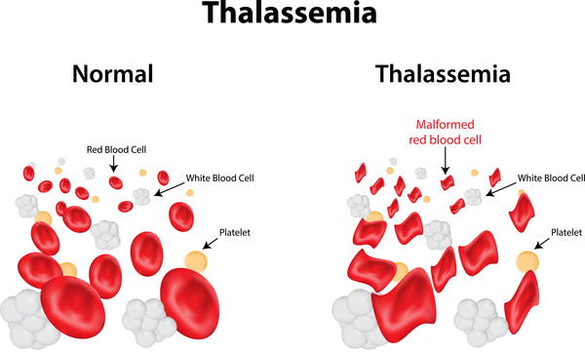

Slide 12
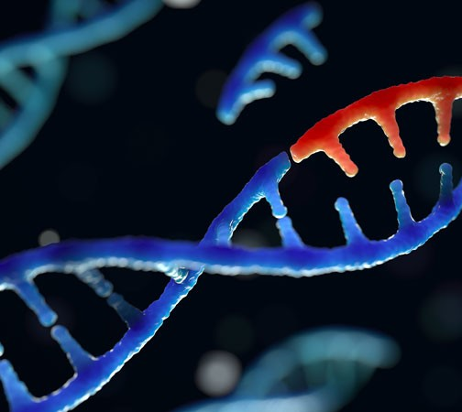
Etiological Factors
Abnormal HB production
Family disorder
Asian, Chinese, Mediterranean or African ethnicity.
Mutation in the DNA of cell that makes hemoglobin.

Slide 13
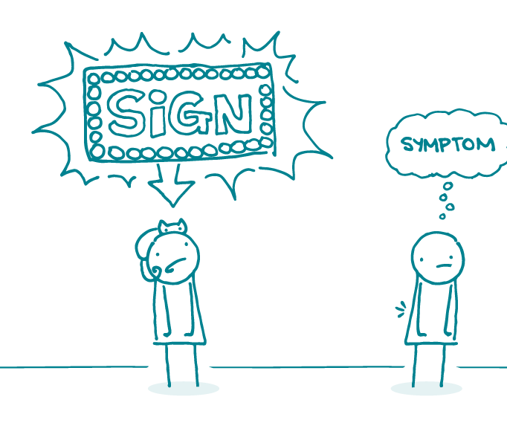
CLINICAL MANIFESTATION
Fatigue
Weakness
Pale or yellowish skin
Facial bone deformities
Slow growth
Abdominal swelling
Dark Urine
Shortness of breath
Failure to thrive
Enlarge spleen and level

Slide 14
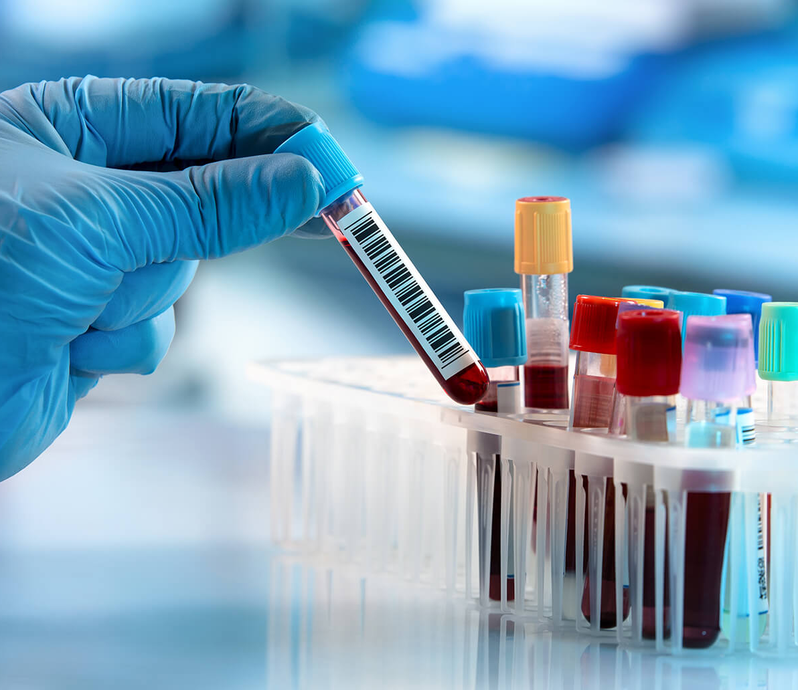
Diagnostic Evaluation
History collection
Physical examination
Blood Test
Mutational analysis
Molecular Diagnostic Test

Slide 15

Medical Management
Thalassemia minor usually dose not require treatment .
For thalassemia major the treatment goals are to provide adequate normal Hb for erythropoiesis.
Iron chelation with deferoxamine is necessary.
Genetic counselling and testing

Slide 16

Pharmacologic Management
Antipyretics
Antihistamine
Chelating agents
Corticosteroids ( Deferoxamine )
Vitamins
Growth hormones

Slide 17

Surgical Management
Bone marrow transplantation
Splenectomy

Slide 18
Nursing Management
Nursing Diagnosis
Ineffective tissue perfusion related to reduced cellular component as evidenced by cyanosis.
Activity intolerance related to imbalance of oxygen supply and consumption need as evidenced by fatigue
Imbalance nutrition less than body requirements related to lack of appetite as evidenced by weight.
Risk for delayed growth and development related to decreased tissue perfusion as evidenced by physical examination.
Ineffective family coping related to impact of the disease to family functioning as evidenced by observation.
Deficient knowledge related to lack of resources as evidenced by verbalize inaccurate information.

Slide 19
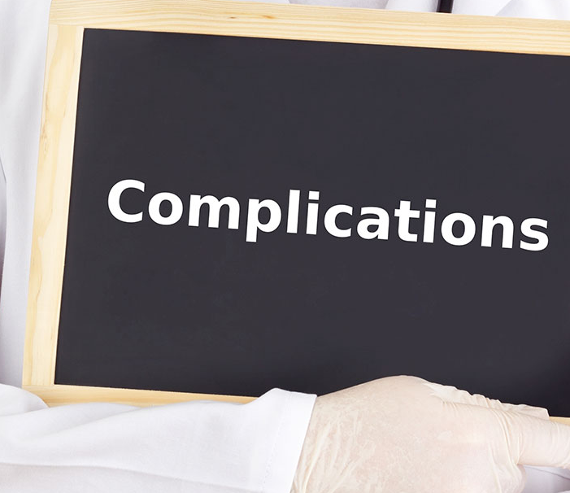
Complications
Heart disease
Lever disease
Endocrine problems
Delayed growth
Osteoporosis
Thrombophilia

Slide 20

Prevention
Thalassemia can not be prevented because it is an inherited disorder
It is possible to identify carriers of this disorder with genetic testing.

Slide 21


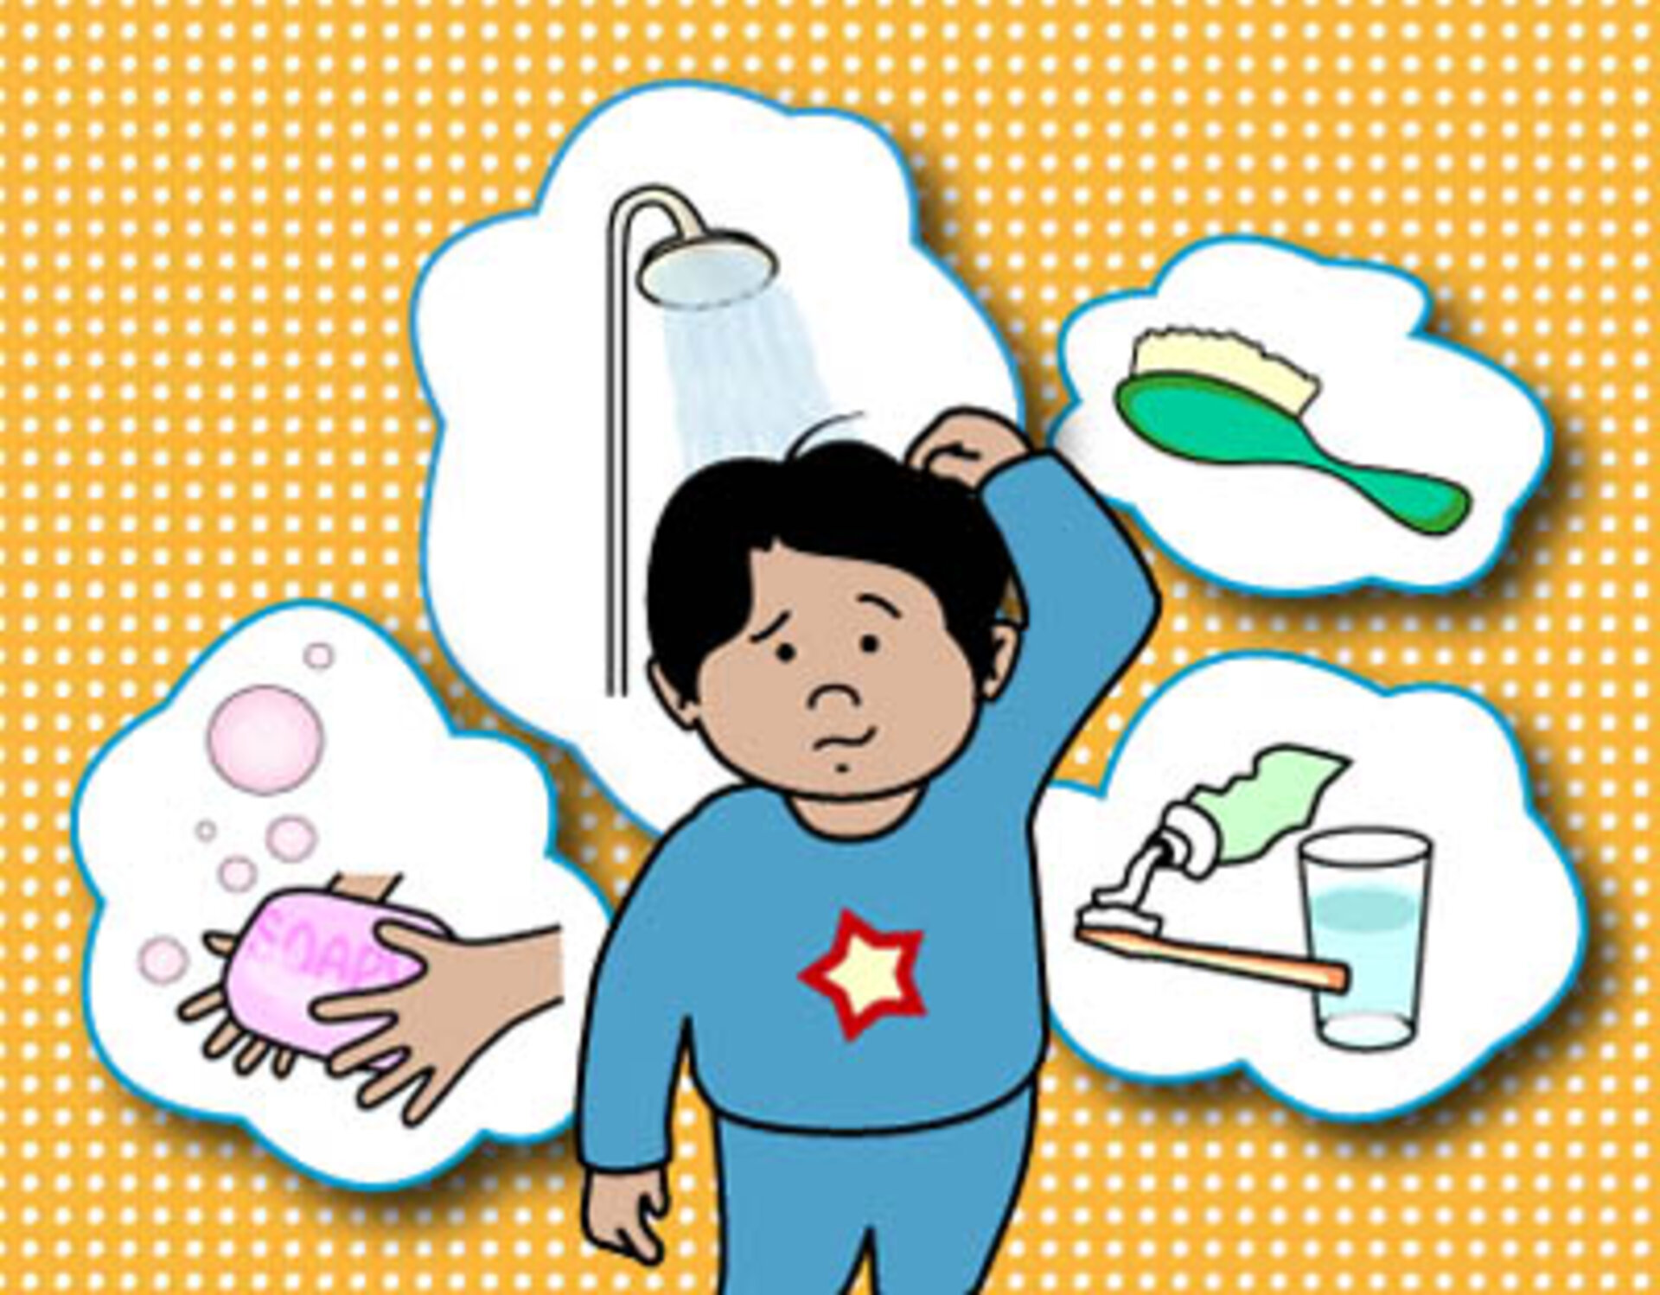


Health Education

Slide 22

At the end of my seminar students able to know about thalassemia, its etiology, clinical manifestation, diagnostic evaluation, treatment, management and complications and preventions,

Slide 23
Bibliography
“Siddarth and burner” textbook of medical surgical nursing, 12th edition. Page No. 925 - 928
“Parul Datta” textbook of pediatric nursing 2nd edition. Page No. 146-148
www.authorstream.com
www.slideshare.com
www.google.com

Slide 24


